Slide 1
Classification with Logistic Regression
Discussion Mini Lecture 6
Discriminative Functions, Logistic Regression, & Evaluation Metrics

Slide 2
Classification Problems
Logistic Regression
Classification Metrics
Multi-Class Extension

Slide 3
Binary Classification & Discriminative Models
Classification Problems
Logistic Regression
Classification Metrics
Multi-Class Extension

Slide 4
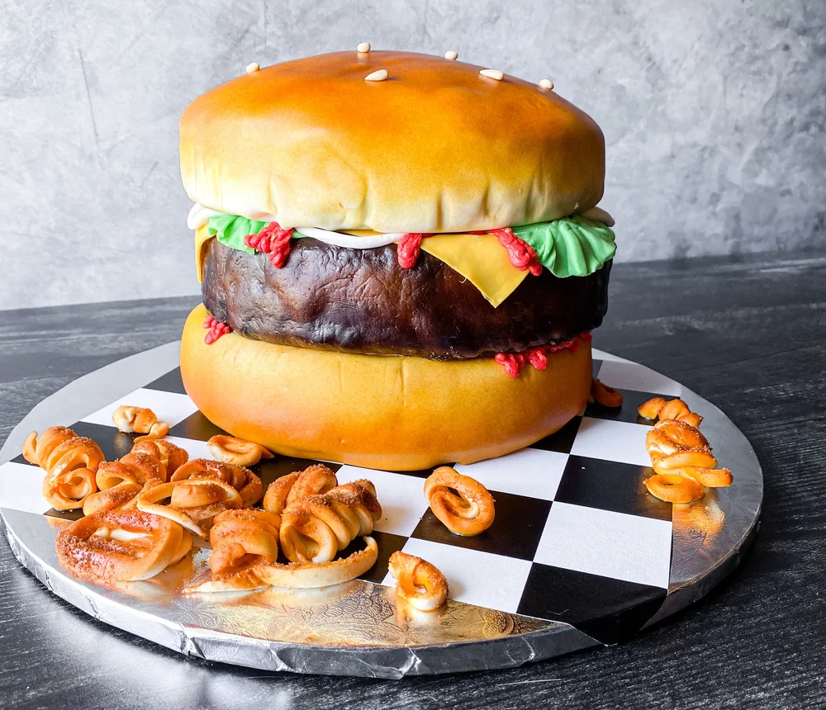
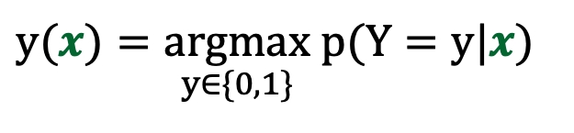

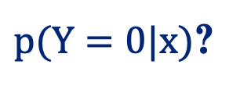

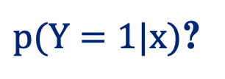
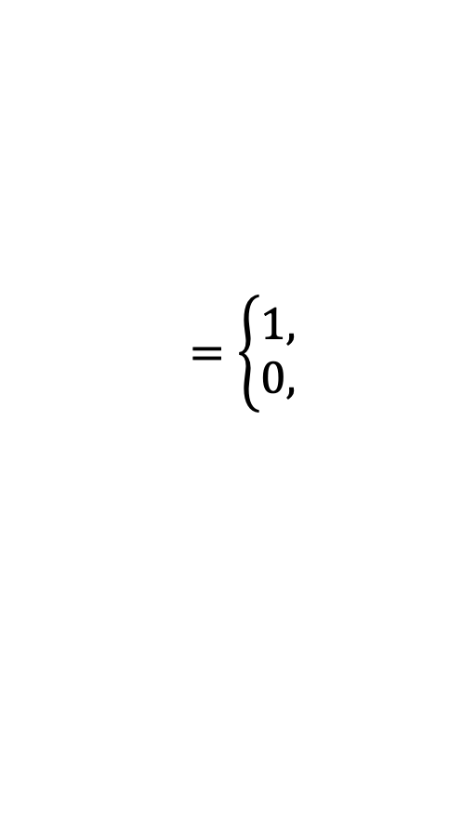
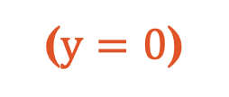

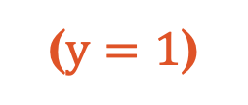
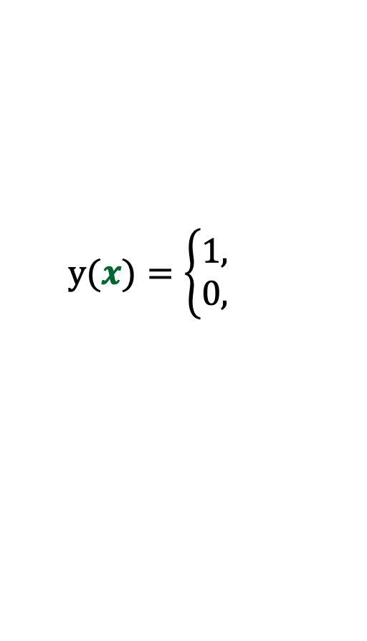
Binary Classification: Symmetric Loss
How do we predict whether something is real or cake?
real
$p(Y=1|x)$?
One approach:
($y=1$)
Maximize the posterior!
cake
$$y(x)=\underset{y∈\{0,1\}}{argmax} p(Y=y|x)$$
$p(Y=0|x)$?
($y=0$)
$$y(x)=\left\{\begin{matrix}1, \\ 0,\end{matrix}\right.$$
$$p(Y=1|x)≥p(Y=0|x)$$
$$x∈ℝ^{D}$$
otherwise
$$=\left\{\begin{matrix}1, \\ 0,\end{matrix}\right.$$
$$p(Y=1|x)≥1/2$$
otherwise

Slide 5
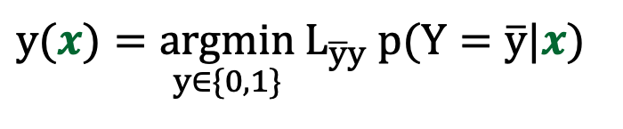
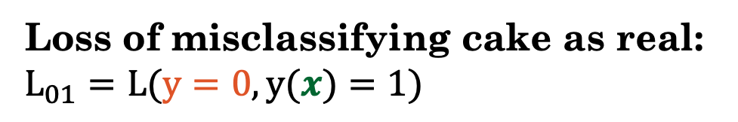


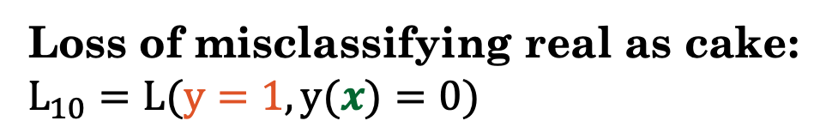
Binary Classification: Asymmetric Loss
What if misclassifying a real object is worse than misclassifying cake?
real
$p(Y=1|x)$?
Another approach:
($y=1$)
Minimize the risk (expected loss)!
cake
$$y(x)=\underset{y∈\{0,1\}}{argmin}{ L}_{\overline{y}y} p(Y=\overline{y}|x)$$
$p(Y=0|x)$?
($y=0$)
$$y(x)=\left\{\begin{matrix}1, \\ 0,\end{matrix}\right.$$
$$L_{01}p(Y=0|x)≤L_{10}p(Y=1|x)$$
$$x∈ℝ^{D}$$
otherwise
Loss of misclassifying cake as real:
$$L_{01}=L(y=0, y(x)=1)$$
$$=\left\{\begin{matrix}1, \\ 0,\end{matrix}\right.$$
$$p(Y=1|x)≥L_{01}/(L_{01}+L_{10})$$
otherwise
Loss of misclassifying real as cake:
$$L_{10}=L(y=1,y(x)=0)$$

Slide 6
Discriminative Models
This seems reasonable! But what is $p(Y=y|x)$?
We generally don’t know $p(Y=y|x)$, but we could estimate it!
Models that assume a form of the posterior distribution and fit the parameters to make predictions are called discriminative models.
A popular example of a discriminative model is logistic regression.

Slide 7
Logistic Regression: Problem & Solution
Classification Problems
Logistic Regression
Classification Metrics
Multi-Class Extension

Slide 8
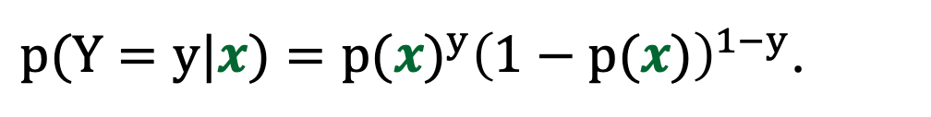

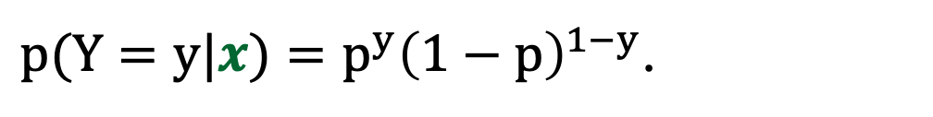
The Logistic Regression Assumption
How do we estimate $p(Y=y|x)$ in logistic regression?
A natural choice: Assume $Y|X\sim Bernoulli(p)$, where $p$ is the probability of success (i.e., the probability an object is real), so
$p(Y=y|x)=p^{y}{\left(1−p\right)}^{1−y}$.
How do we choose the probability of success, $p=p(Y=1|x)$?
We could observe a set of $N$ objects and let $p=\frac{\# of real objects}{N}$.
But if we observe some features, $x$, that should inform our decision. Let’s then assume the probability of success is a function of $x$, so
$p(Y=y|x)={p(x)}^{y}{\left(1−p(x)\right)}^{1−y}$.

Slide 9
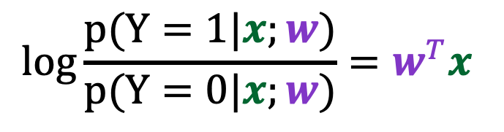

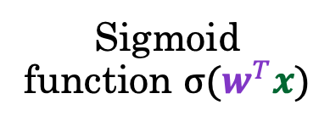
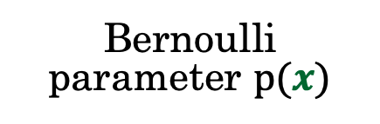
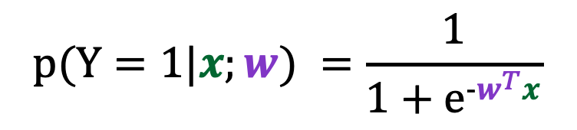
The Sigmoid Function
How does this Bernoulli parameter vary with $x$?
Key insight: The log-odds of a binary event are often approximately linear in the features…
$$p(Y=1|x;w) =\frac{1}{1+e^{−w^{T}x}}$$
$$log\frac{p(Y=1|x;w)}{p(Y=0|x;w)}=w^{T}x$$
*
$$≡$$
Bernoulli parameter $p(x)$
Sigmoid function $σ(w^{T}x)$
$$∴ p(Y=y|x;w)={σ(w^{T}x)}^{y}{\left(1−σ(w^{T}x)\right)}^{1−y}$$
We’ll show this equivalence in Problem 2 on Disc. 6 worksheet.
* We can always augment our features with one to allow for a bias term.

Slide 10
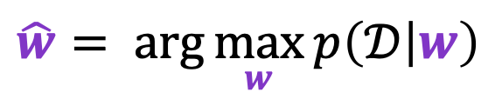
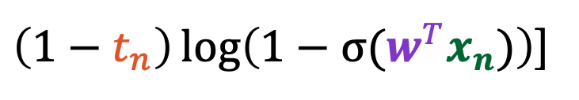
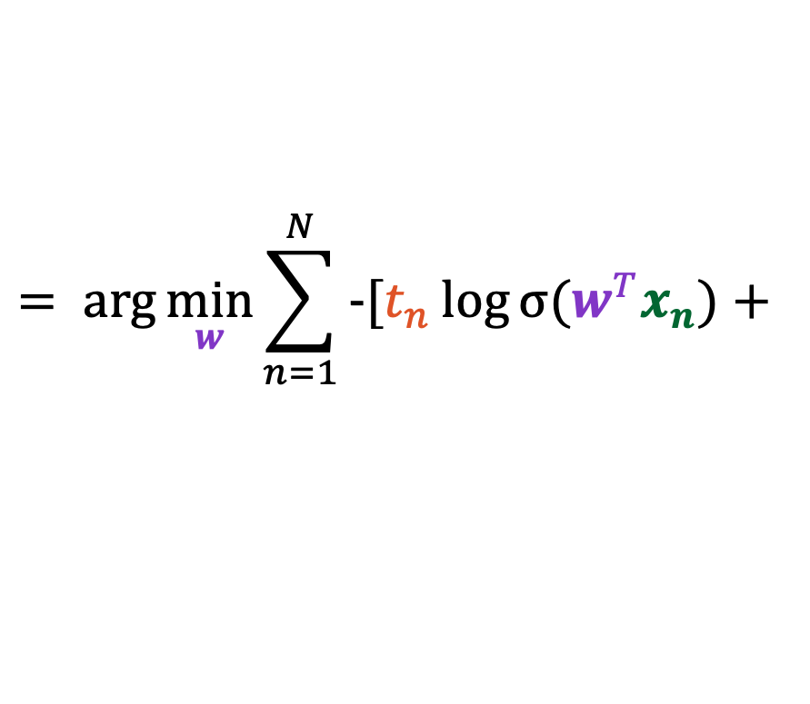
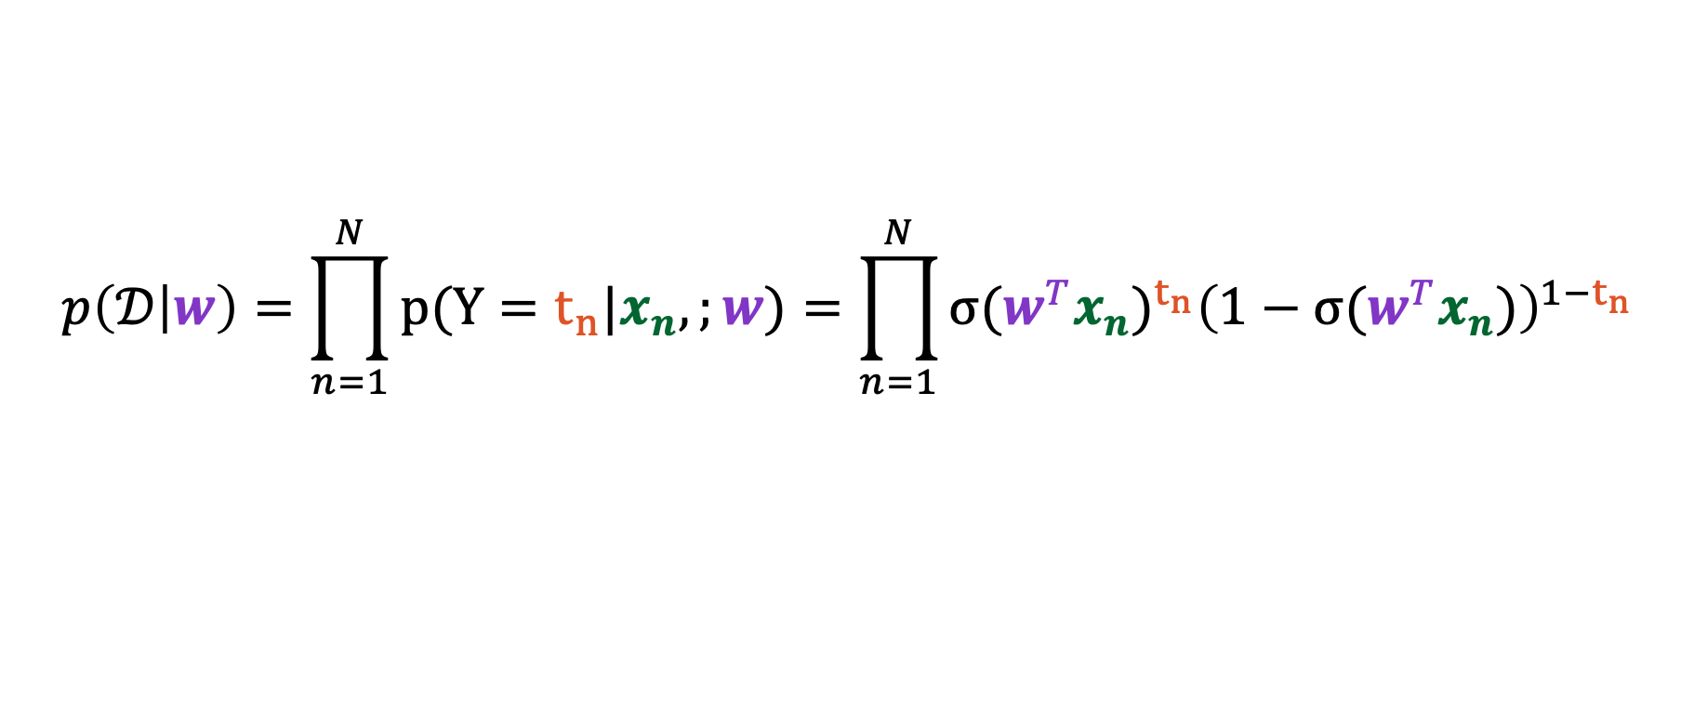
Logistic/Cross-Entropy Loss
We’ll show this equivalence in Problem 2 on Disc. 6 worksheet.
Now how do we estimate the linear parameters, $w$?
The classic approach: Maximum likelihood estimation (MLE)
For a dataset $𝒟{=\{(x_{n},t_{n})\}}_{n=1}^{N}$ of IID samples, the likelihood is
$$p\left(𝒟 | w\right)=\prod_{n=1}^{N}{p(Y=t_{n}|x_{n},;w)}=\prod_{n=1}^{N}{{σ(w^{T}x_{n})}^{t_{n}}{\left(1−σ(w^{T}x_{n})\right)}^{1−t_{n}}}$$
The MLE is
$$\hat{w}= arg{\max_{w}{p\left(𝒟 | w\right)}}$$
Logistic/cross-entropy loss
$$= arg{\min_{w}{\sum_{n=1}^{N}{-[t_{n}\log{σ(w^{T}x_{n})}+ }}}$$
$\left(1−t_{n}\right)\log\left(1−σ(w^{T}x_{n})\right)$]

Slide 11
How to Solve Logistic Regression
Now how do we solve this optimization problem?
While this is a convex optimization problem, it does not admit a “closed-form” solution (unlike linear regression).
We can solve this problem using gradient descent, as we will show in the next two lectures :)

Slide 12
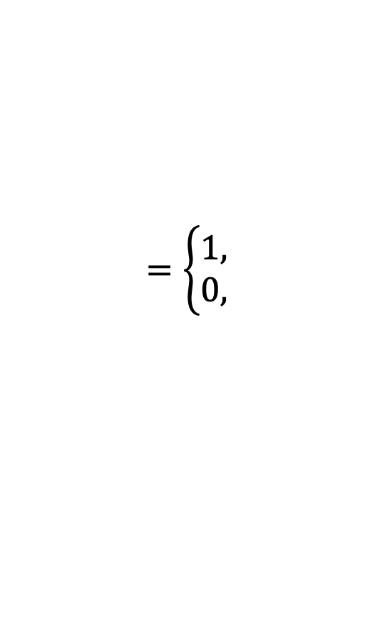




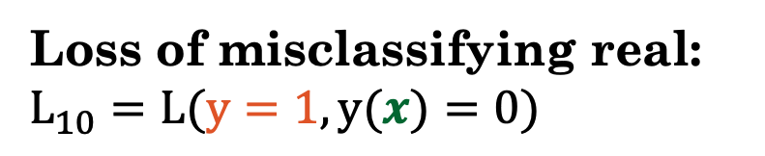

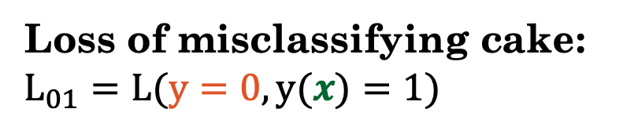
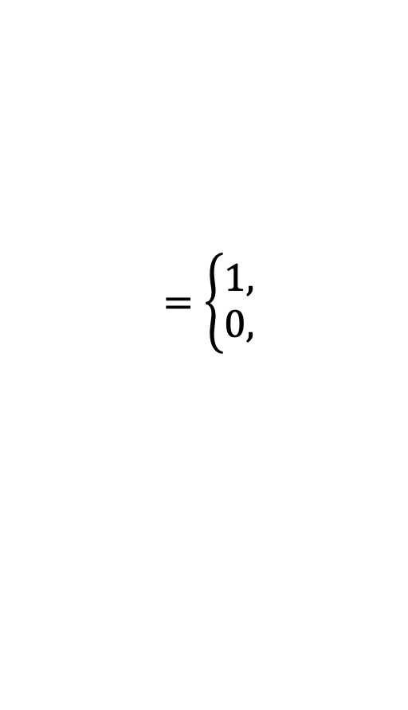

Logistic Regression Decision Function
A) Symmetric Loss: Maximize the posterior.
$$y(x)=\left\{\begin{matrix}1, \\ 0,\end{matrix}\right.$$
$$p(Y=1|x;w)≥1/2$$
otherwise
$$=\left\{\begin{matrix}1, \\ 0,\end{matrix}\right.$$
$$σ(w^{T}x)≥1/2$$
otherwise
B) Asymmetric Loss: Minimize the risk (expected loss).
$$y(x)=\left\{\begin{matrix}1, \\ 0,\end{matrix}\right.$$
$$p(Y=1|x;w)≥L_{01}/(L_{01}+L_{10})$$
Loss of misclassifying cake:
$$L_{01}=L(y=0,y(x)=1)$$
otherwise
$$=\left\{\begin{matrix}1, \\ 0,\end{matrix}\right.$$
$$σ(w^{T}x)≥L_{01}/(L_{01}+L_{10})$$
Loss of misclassifying real:
$$L_{10}=L(y=1,y(x)=0)$$
otherwise

Slide 13
Evaluating Classification Models
Classification Problems
Logistic Regression
Classification Metrics
Multi-Class Extension

Slide 14
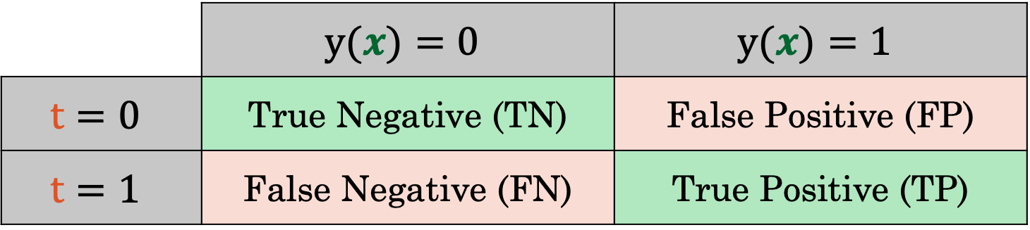
Binary Classification Outcomes
positive sample – in the class of interest (i.e., real)
negative sample – not in the class of interest (i.e., cake)
Prediction
 | $$y(x)=0$$ | $$y(x)=1$$
$$t=0$$ | True Negative (TN) | False Positive (FP)
$$t=1$$ | False Negative (FN) | True Positive (TP)
Actual

Slide 15

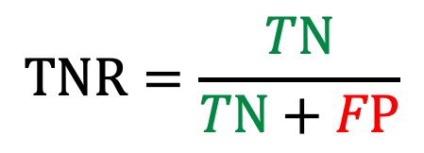

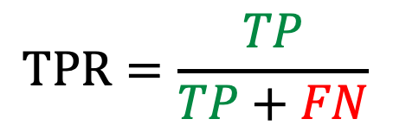

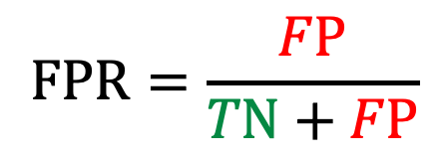
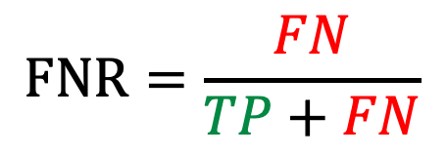
Classification Performance Metrics
True positive rate (sensitivity):
False negative rate:
$$+$$
$$=$$
$$1$$
$$TPR=\frac{TP}{TP+FN}$$
$$FNR=\frac{FN}{TP+FN}$$
True negative rate (specificity):
False positive rate:
$$+$$
$$=$$
$$1$$
$$TNR=\frac{TN}{TN+FP}$$
$$FPR=\frac{FP}{TN+FP}$$

Slide 16
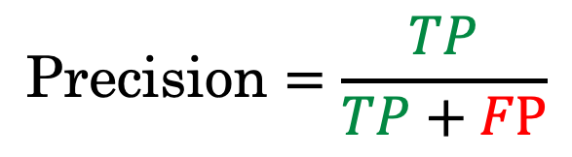
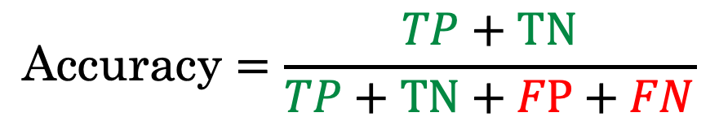
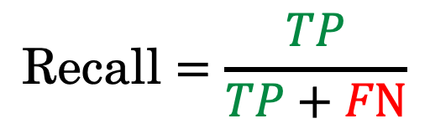
Classification Performance Metrics
$$\text{Accuracy}=\frac{TP+TN}{TP+TN+FP+FN}$$
What proportion of all points were correctly classified?
$$\text{Precision}=\frac{TP}{TP+FP}$$
What proportion of positive predictions were correct?
$$\text{Recall}=\frac{TP}{TP+FN}$$
*
What proportion of positive points were correctly classified?
We’ll review these in Problem 1 on the Disc. 6 worksheet.
* Recall is the same as TPR/sensitivity from the previous slide.

Slide 17
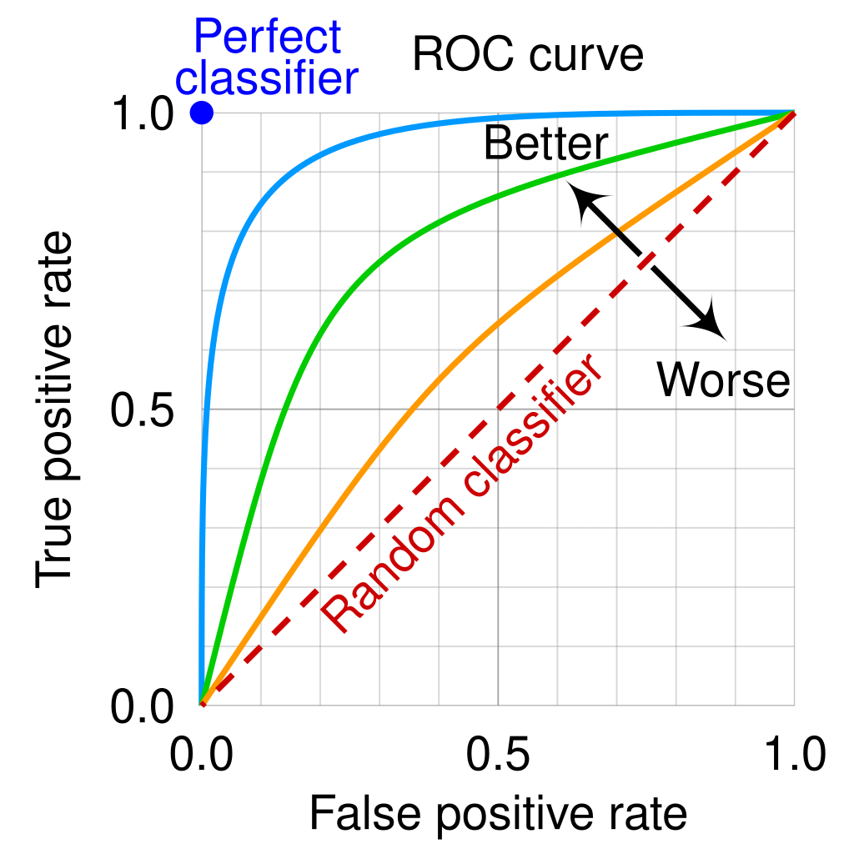
Receiver Operating Characteristic (ROC) Curve
The ROC curve is generated for a trained binary classifier across a range of thresholds.
The total area under the curve (AUC) ranges from 0.5 for a random classifier to 1.0 for a perfect classifier.
Source: https://en.wikipedia.org/wiki/Receiver_operating_characteristic

Slide 18
How do we select a performance metric?
These are a few popular metrics, but there are many more.
The metric we choose to evaluate our binary classification model is highly dependent on the problem we’re developing the model for and the notion of bias/fairness most relevant to our domain.
We’ll discuss examples in Problem 1 on the Disc. 6 worksheet.

Slide 19
Classification with More than 2 Classes
Classification Problems
Logistic Regression
Classification Metrics
Multi-Class Extension

Slide 20


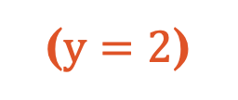
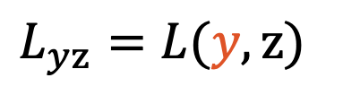

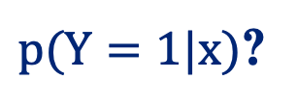
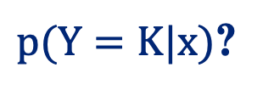
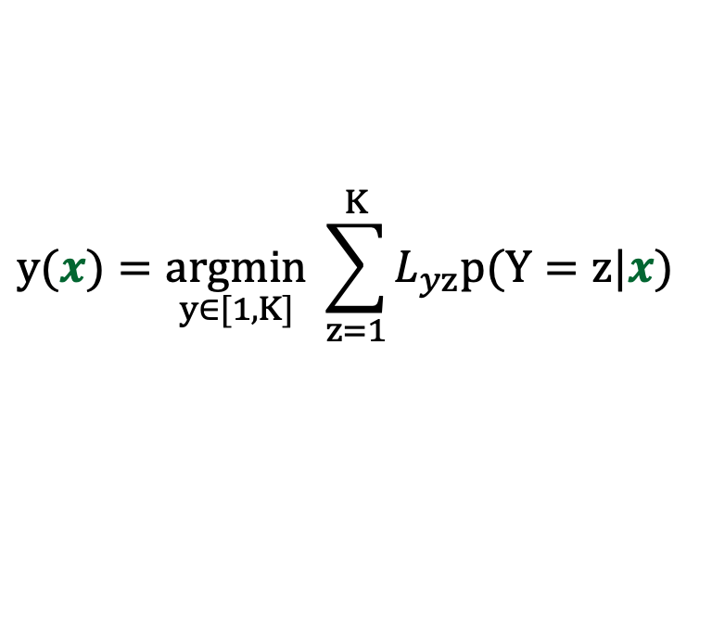
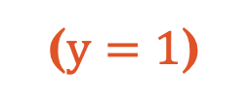
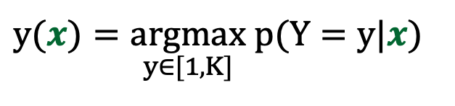
General Classification Problem
What if we have more than two classes?
$p(Y=1|x)$?
Holstein
($y=1$)
Symmetric Loss:
Maximize the posterior!
Angus
($y=2$)
$$y(x)=\underset{y∈[1,K]}{argmax} p(Y=y|x)$$
…
Hereford
($y=K$)
$p(Y=K|x)$?
$$x∈ℝ^{D}$$
Asymmetric Loss:
Minimize the risk!
Loss of misclassifying a $y$ cow as $z:=y(x)$:
$$y(x)=\underset{y∈[1,K]}{argmin} \sum_{z=1}^{K}{L_{yz}p(Y=z|x)}$$
$$L_{yz}=L(y,z)$$

Slide 21
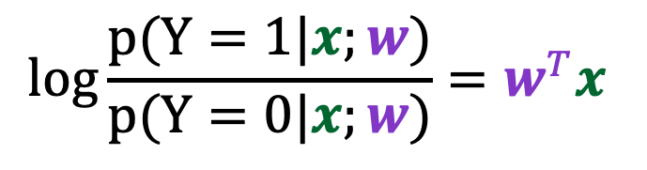
The Softmax Function
Now how do we estimate $p(Y=y|x)$ in the multi-class case?
When discussing binary classification, we said the log-odds of a binary event are often approximately linear in the features:
$$log\frac{p(Y=1|x;w)}{p(Y=0|x;w)}=w^{T}x$$
Effectively, we assume the log-odds of the positive (real) class relative to the negative (cake) class are linear.

Slide 22
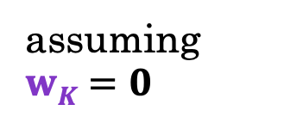
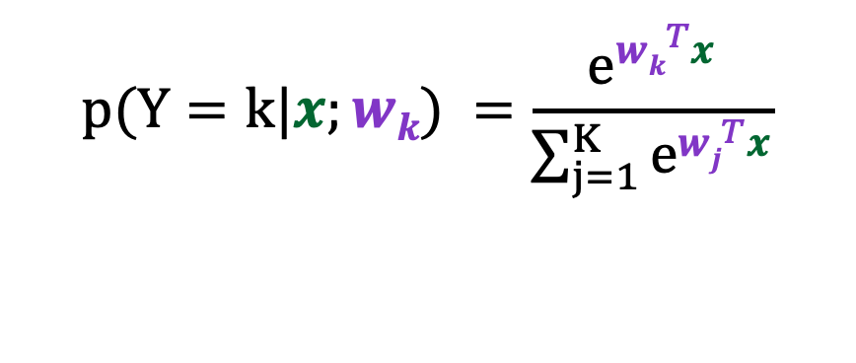

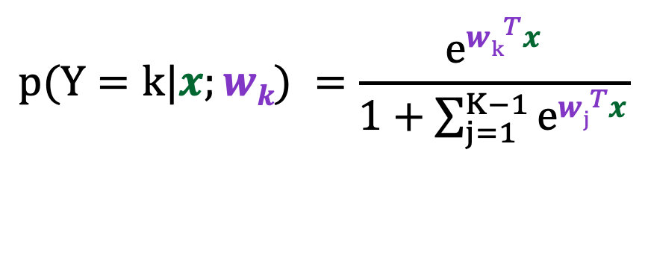
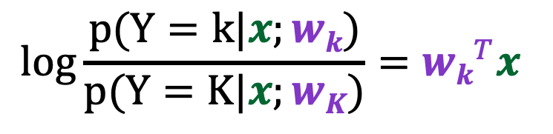
The Softmax Function
Now how do we estimate $p(Y=y|x)$ in the multi-class case?
Let $K$ be a reference class and consider the log-odds of each class $k∈[1,K−1]$ relative to this reference:
$$log\frac{p(Y=k|x;wk)}{p(Y=K|x;wK)}={wk}^{T}x$$
$$p(Y=k|x;wk) =\frac{e^{{wk}^{T}x}}{1+\sum_{j=1}^{K−1}{e^{{wj}^{T}x}}}$$
$$≡$$
assuming $wK=0$
$$p(Y=k|x;wk) =\frac{e^{{wk}^{T}x}}{\sum_{j=1}^{K}{e^{{wj}^{T}x}}}$$

Slide 23
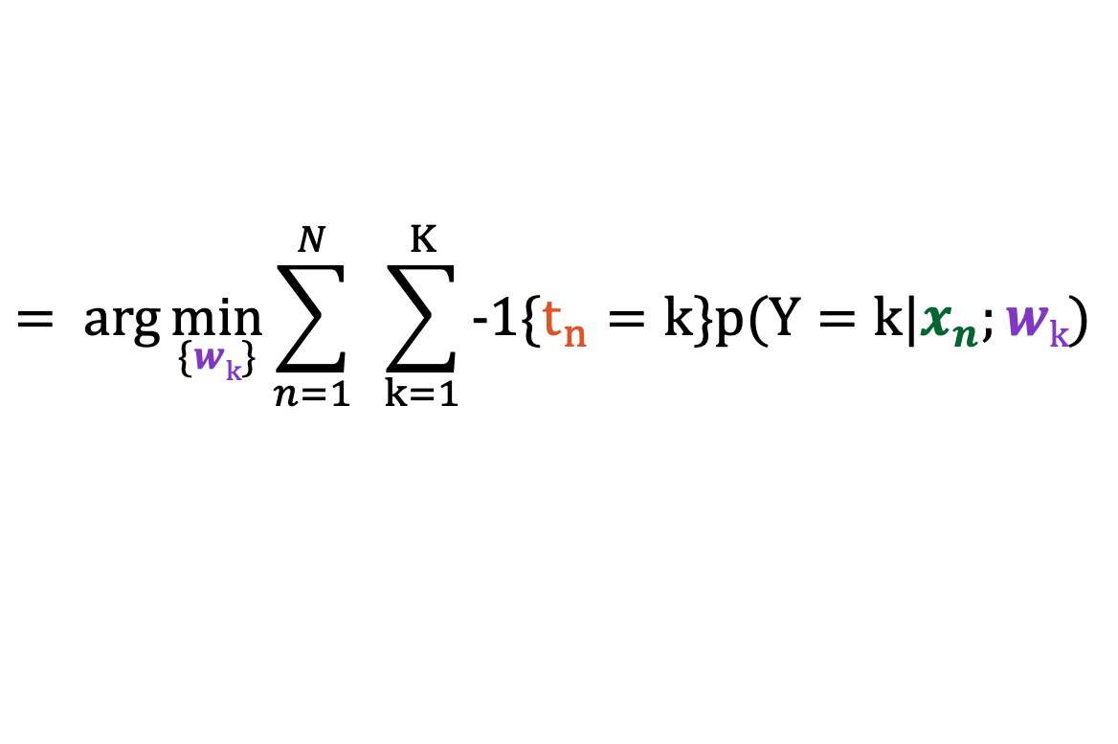
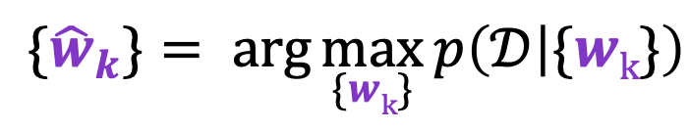
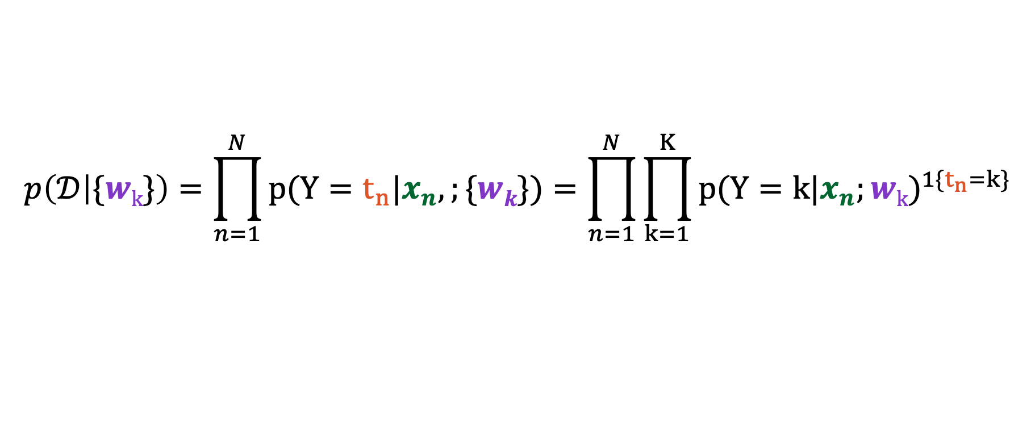
Multiclass Cross-Entropy Loss
Again, we estimate our linear parameters ${\{wk\}}_{k=1}^{K−1}$ using MLE.
For a dataset $𝒟{=\{(x_{n},t_{n})\}}_{n=1}^{N}$ of IID samples, the likelihood is now
$$p\left(𝒟 | \{wk\}\right)=\prod_{n=1}^{N}{p(Y=t_{n}|x_{n},;\{wk\})}=\prod_{n=1}^{N}{\prod_{k=1}^{K}{{p(Y=k|x_{n};wk)}^{1\{t_{n}=k\}}}}$$
The MLE is
$$\{{\hat{w}}_{k}\}= arg{\max_{\{wk\}}{p\left(𝒟 | \{wk\}\right)}}$$
$$= arg{\min_{\{wk\}}{\sum_{n=1}^{N}{ }\sum_{k=1}^{K}{-1\{t_{n}=k\}p(Y=k|x_{n};wk)}}}$$

Slide 24
Classification with Logistic Regression
Discussion Mini Lecture 6
Contributors: Sara Pohland

Slide 25
Additional Resources
Classification Problems
Deep Learning Foundations and Concepts – Chapter 5.1, 5.2, 5.4
Sara’s notes on Machine Learning – Section 5
Logistic Regression
Deep Learning Foundations and Concepts – Chapter 5.4.3
Sara’s notes on Machine Learning – Section 9.5
Classification Metrics
Deep Learning Foundations and Concepts – Chapter 5.2.5, 5.2.6
More on Precision & Recall
More on ROC and other metrics
Connection of metrics to Fairness/Bias
Multi-Class Extension
Deep Learning Foundations and Concepts – Chapter 5.4.4

